Slide 1

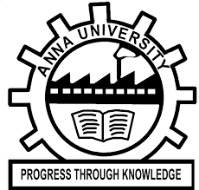

KONGUNADU COLLEGE OF ENGINEERING AND TECHNOLOGY
(AUTONOMOUS)
Tholurpatti (P.O), Thottiam –T.K, Trichy – 621 215.
Department of Electronics and Communication Engineering
HX8001 - PROFESSIONAL READINESS FOR INNOVATION, EMPLOYABILITY AND ENTREPRENEURSHIP
PROJECT TITLE
Domain of the Project : CLOUD APPLICATION DEVELOPMENT
Batch ID : B7-1A3E
Team ID : PNT2022TMID13250
Academic Year : 2022-2023
Year/Semester : IV/VII
Team Members:
BARATH S (621319104009)
KOWSIK V (621319104028)
SIVABALAN T (621319104053)
SURENDHAR S (621319104009)
Mentor:
Mr. K. ANGURAJU

Slide 2
TABLE OF CONTENTS
S.No. | Content | Slide No.
1 | Objectives | 3
2 | Abstract | 4
3 | Introduction | 5
4 | Literature Survey | 6
5 | Problem Identification | 9
6 | Block Diagram | 10
7 | References | 11

Slide 3
OBJECTIVES
With the advancement in the medical department finding the plasma donor has been a major issue.
With this aim an application has been designed which connect the patient with the local donors.
The donors will get notified in case if their blood or plasma is needed the patient.
3

Slide 4
ABSTRACT
The requirement of blood plasma had increased, but unfortunately the donor count was low.
To overcome this problem we have planned to develop an application in which the Donor users can register to the application to receive notification about blood donation requests
4

Slide 5
INTRODUCTION
Every minute on every day somebody is in need of blood and blood components such us plasma and RBC.
But the need was not satisfied, This is because that there is no platform to connect local blood donors with patients.
5

Slide 6
Literature Survey
TITLE | AUTHOR & YEAR | JOURNAL NAME | REMARKS
Blood donation smartphone app | Afaf AliBatis, Ahmed Albarrak & 2021 | Science Direct | The top rated features were the ability to request for blood donors, and the ability to locate the nearest blood center on the map.The preferred method of contact was found to be SMS.
Android application for Medicine donation | Netra Shigwan, Pratiksha Chaudhari, Shweta Pawar, Anuja Gote & 2020 | International Research Journal of Engineering and Technology (IRJET) | In this system, there are three entities,admin,Volunteer,andusers. Users can post Available medicine with the medicine name, medicine description ,QRcode, and medicine expired date. WhenAdmin assign him medicines, he can open the user’s address location on the Google map and go to thatlocation and bring the medicines.
6

Slide 7
Literature Survey
TITLE | AUTHOR & YEAR | JOURNAL NAME | REMARKS
Mobile phone based system to promote eye donation | WarapornChumkasian, RitinFernand, Khin ThanWin, HeidiLord & 2021 | Science Direct | Eye Donor Form generates form using any smartphone .The donation form input is saved electronically and can be forwarded to your family members, healthcare.
Instant plasma donor recipient connector web application | Kalpana Devi Guntoju, Tejsvini Jalli, Sreejauppla & 2022 | International Research Journal Of Modernization in engineering Technology and Science | In this proposed system, a donor who wants to donate plasma and can donate the plasma to a blood bank. The blood bank after checking the donor certificate can make a request to the donor.
7

Slide 8
Literature Survey
TITLE | AUTHOR & YEAR | JOURNAL NAME | REMARKS
BLOODR : blood donor and requester mobile application | Vamsi krishna tatikonda, hosam el-ocla & 2021 | mHealth | BLOODR application creates communication channel through authenticated clinics whenever a patient needs blood donation. It is a useful tool to find compatible blood donors who can receive blood request posts in their local area.
Blood donation and life saver-blood donation app | M.R. Anish Hamlin, J. Albert Mayan& 2020 | IEEE | At the emergency time of blood needed we can check for blood donor nearby by using GPS. Once the app user enter the blood group which he/she needed it will automatically show the donor nearby and send an alert message to the donor.
8

Slide 9
PROBLEM IDENTIFICATION
During the COVID 19 crisis, the requirement of plasma became high, It is very difficult find the respective blood group donors when anyone is in need.
In regard to the problem faced, an application is to be built which would take the donor details store it and inform them upon a request.
9

Slide 10
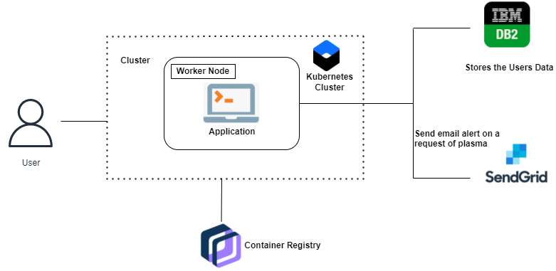
Block Diagram
10

Slide 11
REFERENCES
Vamsi Krishna Tatikonda and Hosam El-Ocla. BLOODR: blood donor and requester mobile application. mHealth on sep 18 2017.
Blood, organ and tissue donation -The need of blood donation in Canada, link:http://healthycanadians.gc.ca/diseases-conditions-maladiesaffections/ donation-contribution-eng.php.
Blood App, American Red Cross, 2016. link: http://www.redcrossblood.org/ bloodapp
Kalpana Devi Guntoju, Tejaswini Jalli, Sreeja Uppala, Sanjay Mallisetti, International Research Journal of Modernization in Engineering Technology and Science, Instant plasma donor recipient connector web application, Volume:04/Issue:06/June-2022
A.Beurel, F.Terrade, J.-P.Lebaudy, B.Danic, Science direct, Determinants of plasma donation: A review of the literature, Volume 24, Issue 3, September 2017
11

Slide 12
REFERENCES
A. Meiappane,K. Logavignesh,R. Prasanna,T.Sakthivel,Blood Donation App Using Android, IEEE International Conference on System, Computation, Automation and Networking (ICSCAN), 29-30 March 2019
Altahir Saad ,Ahmed Saad,Lars Rune Christensen, Blood Donation & Blood Banks through Android Mobile App and Web Application System , International Journal of Computer Science Trends and Technology (IJCST) ,Mar - Apr 2019
Nikita M. Lunawat, Chetan D. Kshirsagar , Ashish A. Gawhande , Rohini M. Rathod,Blood and organ for patient using andriod application, International Journal of Research in Engineering and Technology,May-2016.
Kavita shirsat, Iqra shaikh,Pradnya Deshmukh,Mayuri lambhate4,Food donation application: food share, International research journal of engineering and technology (IRJET), volume: 08 issue: 05 | May 2021
12

Slide 13
QUESTIONS & DISCUSSION

Slide 14
THANK YOU

